Slide 1

Learn. Imagine. Build. .NET Conf
ASP.NET Core 2.0 Web API
Giovani Decusati
CWI Software
Notes:
Building Web APIs with ASP.NET Core 2.0
https://channel9.msdn.com/Events/dotnetConf/2017/T322
What's New in ASP.NET Core 2.0
https://channel9.msdn.com/Events/dotnetConf/2017/T113
Containerized ASP.NET Core Apps with Kubernetes
https://channel9.msdn.com/Events/dotnetConf/2017/T211

Slide 2
Get started with ASP.NET Core 2.0
Install .NET Core 2.0 from https://dot.net/core
Install Visual Studio from https://visualstudio.com
Notes:
Se instalar o Community marcar as caixinhas do ASP.NET Core

Slide 3
O que é Web API?
Um serviço HTTP
Lógica ou dados acessíveis através do HTTP
Programável
Amplamente utilizado na internet
Notes:
https://blogs.msdn.microsoft.com/martinkearn/2015/01/05/introduction-to-rest-and-net-web-api/

Slide 4
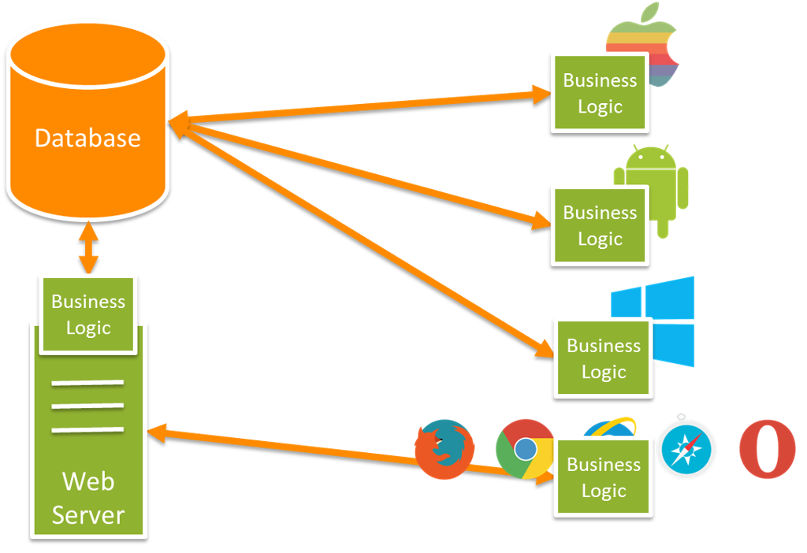

Slide 5
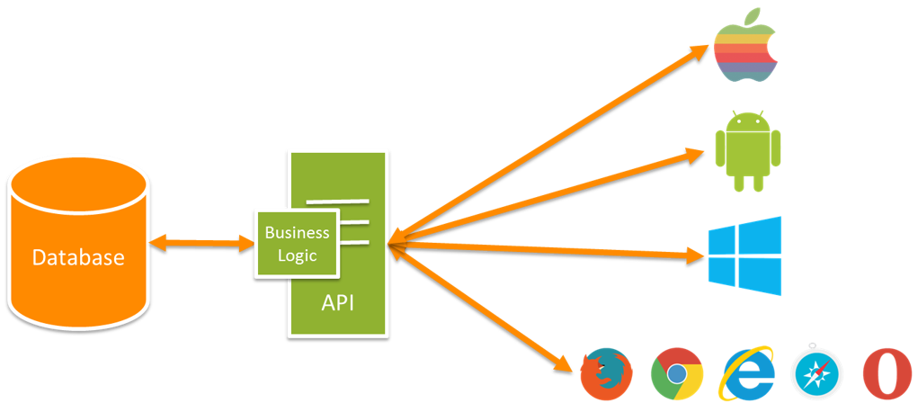

Slide 6
O que é mesmo HTTP?
Protocolo na camada de aplicação – embrace it!
Usado para acessar recursos identificado por uma URI
Ex http://example.com/todolist?priority=important
Acessa os recursos de forma padronizada usando métodos/verbs
GET, POST, PUT, DELETE, etc.
Não mantém o estado entre requisições (stateless)
Headers e Response Bodies – formats!
Códígos que retornam o status de cada resposta
200 OK, 400 Bad Request, 500 Internal Server Error
Notes:
É bem simples, onde qualquer cliente pode operar (interperabilidade)

Slide 7
Lidando com requisições HTTP no ASP.NET Core
O servidor (kestrel) escuta as requisições
O middleware pipeline é chamado para cada requisição
Use MVC para rotear as requisições para a controller e action
O retorno da resposta segue o fluxo do middlware definido no pipeline
Notes:
É importante citar que agora a MS unificou o MVC e API, providenciando o mesmo conjuntos de funcoinalidades

Slide 8
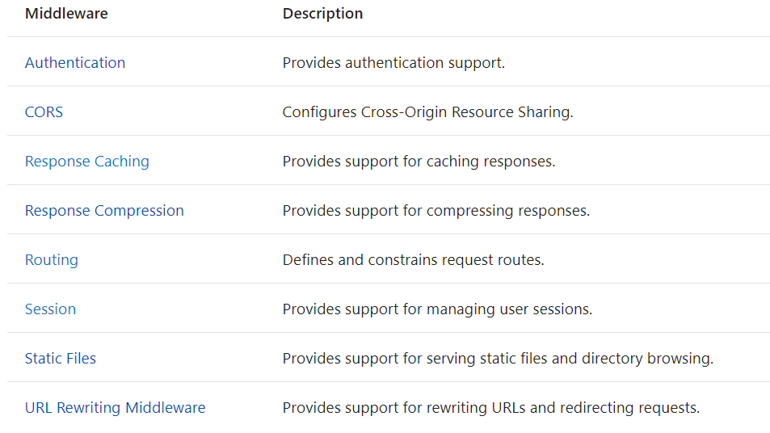
Notes:
Refornçando que tudo é middleware

Slide 9
Como criar uma Web API:
Criar um projeto ASP.NET Core
Setup do MVC
Criar controllers que herdem de ControllerBase
Implementar os metodos das actions
Notes:
ControllerBase não tem suporte a view

Slide 10
Sua primeira Web API
Giovani Decusati
Notes:
Create an empty web app
Setup MVC
Add a Web API controller
Run it and browse to api/values and api/values/123
Run in the debugger and use Postman to send POST, PUT, and DELETE requests

Slide 11
Attribute routing
[HttpGet/Post/Put/Delete(“api/orders”)]
Múltiplos HTTP verbs com AcceptVerbsAttribute
RouteAttribute para especificar métodos HTTP nas rotas das Controller inclusive nas Actions
Notes:
[HttpPost] is shorthand for [AcceptVerbs(HttpVerbs.Post)]. The only difference is that you can't use [HttpGet, HttpPost] (and similar) together on the same action. If you want an action to respond to both GETs and POSTs, you must use [AcceptVerbs(HttpVerbs.Get | HttpVerbs.Post)].

Slide 12
Route templates
Extrair os valores das rotas (ex “api/orders/{id}”)
Tokens (ex “api/[controller]”) para especificar a Controller/Action/Area
Valores opcionais para rotas: {id?}
Valores padrões para rotas: {id=latest}
Constraints: {id:int}

Slide 13
Attribute routing
Giovani Decusati
Notes:
Talk to [controller] route token
Refactor controller name and show route changes
Talk to {id} route value
Comment out first action and show {id?}
Show {id=123}
Show {id:int}

Slide 14
Model binding and validation
Bind request data to action parameters
Bind form data, route values and query string parameters by default
Use [FromBody] to bind the request body using formatters
Use [FromRoute/Query/Form/Header] to restrict model binding to a particular source
Use data annotations and check ModelState.IsValid
Notes:
FromUri -> Query

Slide 15
Model binding and validation
Giovani Decusati
Notes:
Talk to binding of route values
Show binding query string parameter by adding a parameter
Show adding [FromQuery] to id
Create Value type update Post action
Post some JSON
Add some data annotations on the string property (not value typed property)
Should checking ModelState.IsValid

Slide 16
Action results
Used to produce the response
Return IActionResult (or Task<IActionResult>)
Use helper extension methods on ControllerBase
200 OK with formatted content | OK(object)
Bad request with invalid data | BadRequest(ModelState)
Created a new resource | CreatedAtAction(“Get”, new { id = 123})
Return some text | Content(“hello!”)
Return some JSON | Json(object)

Slide 17
Action results
Giovani Decusati
Notes:
Update Get and Post to return IActionResult
Update Get to return Ok(values)
Update Post to return BadRequest(ModelState) or CreatedAtAction(“Get”, new { id = value.Id }, value)

Slide 18
Formatting
Separação de input and output formatters
Configurar formatters através das opções do MVC
Input formatters handle request body formats
Don’t forget [FromBody]!
Output formatters handle response content-negotiation
Constrain formats per action using [Produces/Consumes]
New in 2.0: support for media-type suffixes!
Ex application/foo+json

Slide 19
Formatting
Giovani Decusati
Notes:
Add the XML formatters
Get some JSON and some XML by specifying the Accept header
Add ProducesAttribute to Get to restrict to JSON
Update ProducesAttribute to specify application/dan+json

Slide 20
Acesso a dados
O Entity Framework Core acessa uma variedade de fontes de dados
Injeção do DbContext na Web API para controllers
Scaffolding para gerar Web APIs baseadas no DbContext

Slide 21
Acessando dados
Giovani Decusati
Notes:
Add a Todos class
Add a TodosContext
Add config
Scaffold a TodosController
Add some todos using postman
Get some todos
Delete some todos
https://docs.microsoft.com/en-us/aspnet/core/data/ef-mvc/intro
https://docs.microsoft.com/en-us/ef/core/miscellaneous/testing/in-memory

Slide 22
Open API documents (“Swagger”)
Formato padrão para descrever Web APIs
Documente suas Web APIs
Gerado por .NET community libraries
Use .NET community tools for client code generation
Notes:
Swagger virou padrão de especificação de APIs REST
NSwag

Slide 23
OpenAPI
Giovani Decusati
Notes:
Start with an Angular app
Enable Swagger support
Add a Xamarin forms app
Generate a client using NSwag
Call the Web API from the Xamarin forms app

Slide 24
Additional resources
Docs: https://docs.microsoft.com/aspnet/core
Code: https://github.com/aspnet/home
Postman: https://www.getpostman.com/
Swashbuckle: https://github.com/domaindrivendev/Swashbuckle.AspNetCore
NSwag: https://github.com/RSuter/NSwag

Slide 25




Get started today!
Install .NET Core 2.0 from https://dot.net/core
Install Visual Studio from https://visualstudio.com
Obrigado!
giovani-decusati
giovanidecusati
giovani.decusati@hotmail.com
Giovani Decusati
Notes:
https://docs.microsoft.com/en-us/aspnet/core/data/ef-mvc/intro
https://docs.microsoft.com/en-us/ef/core/miscellaneous/testing/in-memory
https://docs.microsoft.com/en-us/dotnet/standard/net-standard

Slide 26
.NET

